Slide 1
Machine Learning and Pollen Forecasting
Sydney Filler and Kathy Gerst

Slide 2
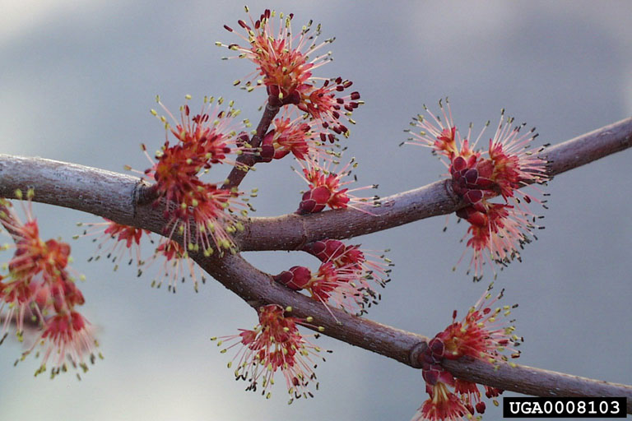
Background
Goals for predicting pollen
Unique challenges posed by pollen data
Why machine learning is a unique solution

Slide 3
Methodology & Data
15 Daymet climate variables from USA-NPN website, used Status and Intensity dataset
Looked activity across 3 days and used proportion of ‘yes’ days as proxy for activity
Used climate variables on the first day of each period
Changes to methodology: weighting status observations by intensity, filling in data gaps

Slide 4
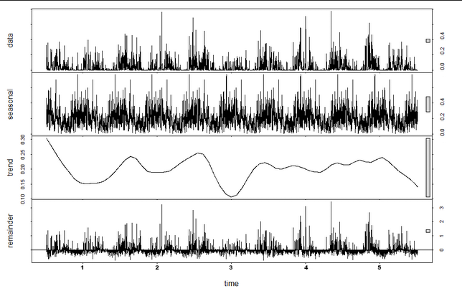
Traditional ARIMA Model
ARIMA models are univariate forecasting models that are uniquely suited for data with ‘seasonality’ and/or long-term trends
Discovered that there is no concise long-term trend for this pollen data; troughs and peaks could be explained by masting or by data
ARIMA model failed to accurately forecast

Slide 5
What is machine learning?
Machine learning programs are given a set of inputs and outputs and attempt to fit a model
Why is it important? How is it different than standard modeling?

Slide 6
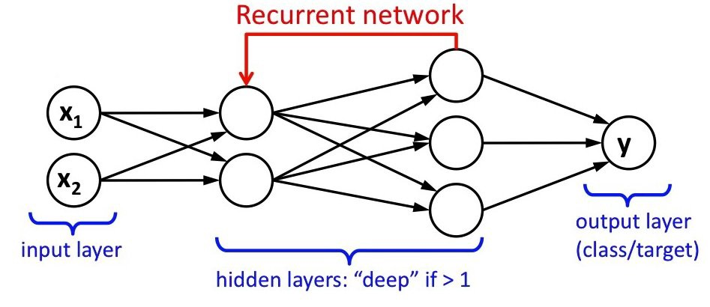
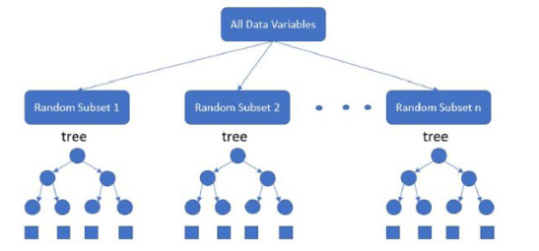
Random Forest vs. RNN

Slide 7
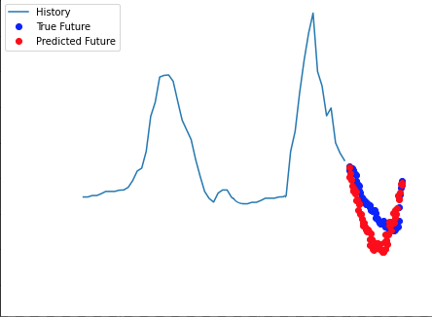
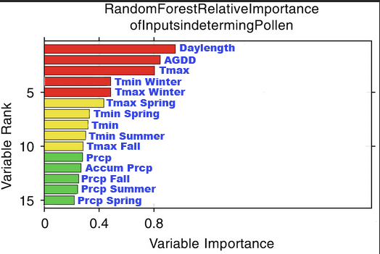
Red Maple: A Case Study
1.0
0.8
0.4
0.2

Slide 8
Red Maple: A Case Study
Kfold cross validation to evaluate the model
Mean Average Percent Error: 2.6% (

Slide 9
What next?
Can we use the limited pollen release data we have as a model variable?
How can we improve model accuracy across species with minimal data?
How can we integrate long-term trends into models?
How can we predict pollen release across a region?

